Slide 1
32 School “St. Kliment Ohridski”

Slide 2
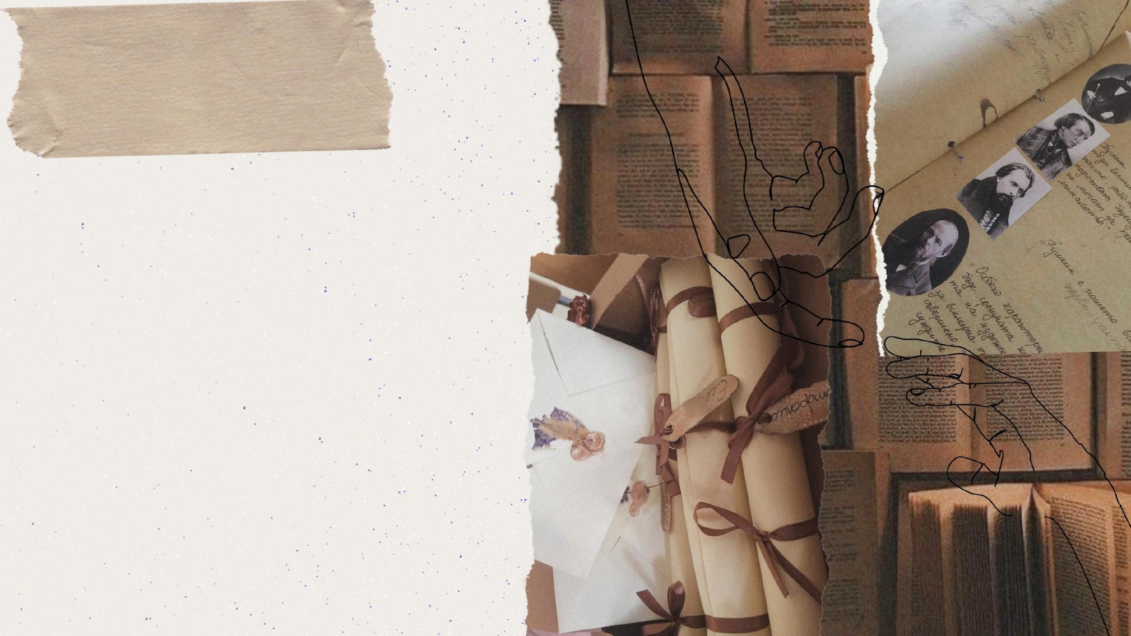
It was founded in 1896 as a woman secondary school and has more than 120 years of history.
A royal decree №10 - "Law on Secondary Girls 'Education" was published in the State Gazette No. 49 on February 20, 1896, which allowed for the establishment of girls' high schools along with men's high schools. to which 2 branches of three classes were opened in the school year 1896/97.One of them marks the beginning of the 3rd girls' high school, opened on 08.09.1896. He had 3 classes, 10 teachers and 214 students. The school was called "Maria Louisa" and his students lived in the Yuch Bunar and Konyovitsa neighborhoods. Many of them were children of poor people, workers and craftsmen and after the Balkan War refugees from Macedonia and Thrace lived here. There were many people willing to study and the school grew, the number of students increased to 1168 in 1901. That is why the Ministry of Public Education, with Minister Dr. Iv. Shishmanov, on September 22, 1903, with speeches delivered by the Minister and the Director - Dr. G. Paunchev, opened a state girls' high school with full independence and a separate budget. In the following year, girls' schools were equated in classes and programs with men's high schools. Then the third girls' high school was the third in the order of the secondary schools in Sofia after the first boys' and the first girls' high school.

Slide 3
Along with the successes, there were many problems that the then One of the most interesting periods in the development of the school was the time when it was led by the principal Mr. Stoyan Kableshkov, the brother of Todor Kableshkov, a hero of the April Uprising. He was a talented teacher with a principals, teachers and students had to deal with. They studied in old residential buildings bought by the Ministry of Education. The narrow bedrooms and kitchens were adapted for classrooms - dark and damp, with poor heating with desks for 6 students each. The 7 buildings could not accommodate the students, so some of them studied in a tobacco warehouse on Opalchenska Street. Ms. Bojorova, a former student, recalls: "In 1939/42 she studied in a building on Opalchenska Street, in a building from Turkish times, then the students went to Nishka Street (today Naycho Tsanov). During the big break they went to the yard of the current school, which then consisted of 3 houses on 2-3 floors, one of which was an administrative building, and the others - the classrooms.
In many places in the old minutes of the pedagogical councils the question is raised about the low teachers' salaries, the inability of the teachers to bear the material difficulties, the lack of books and textbooks, the sufficient equipment in the b . They even collect personal books and make a library for the students. Nevertheless, they manage to maintain their high professionalism, ethical and moral qualities of real teachers, which make their students show deep respect and love for their mentors. To study diligently and well:
“There was strict discipline at school. There was no talk of unexcused absences, no or exceptions. Those who did not behave properly in the trams were punished very severely (their school books were taken away), they were not allowed to go to the cinema after 5 pm, there was a student court for those who behaved rudely towards their teachers or classmates, it was reduced the behavior of not wearing the required hats and uniforms. We didn't like it, but thanks to the strict rules and the wonderful teachers, we got a lot of good knowledge. "
A new page in the history of the school was the construction of the new building, the old wing of the current school on Sofroniy Vrachanski Street and Hristo Botev Blvd.
The foundation stone was laid on June 7, 1942. Students from the 3rd girls' school and students from the 4th men's high school studied in the building. With a decree published in the newspaper "Uchitelsko Delo" from 09.05.1954 the 3rd girls' high school was transformed into 32 Secondary mixed schools with 11 classes, and in the same building there are also 33 SPU "Ernst Telman".
In 1975, only our school remained in the building, which from the following year was called 32 Unified Polytechnic Secondary School with Russian language teaching. Later, along with Russian, the study of English was introduced. From the autumn of 1992, the school began accepting students after 7th grade in classes with intensive study of a foreign language - English or Russian. Since then, our dear school has been named “32 High School with intensive study of foreign languages ​​St. Kliment Ohridski ”
The school was awarded with:
- Order "Cyril and Methodius" - 2nd degree in 1966 and with the Order "Cyril and Methodius" - 1st degree in 1981.

Slide 4
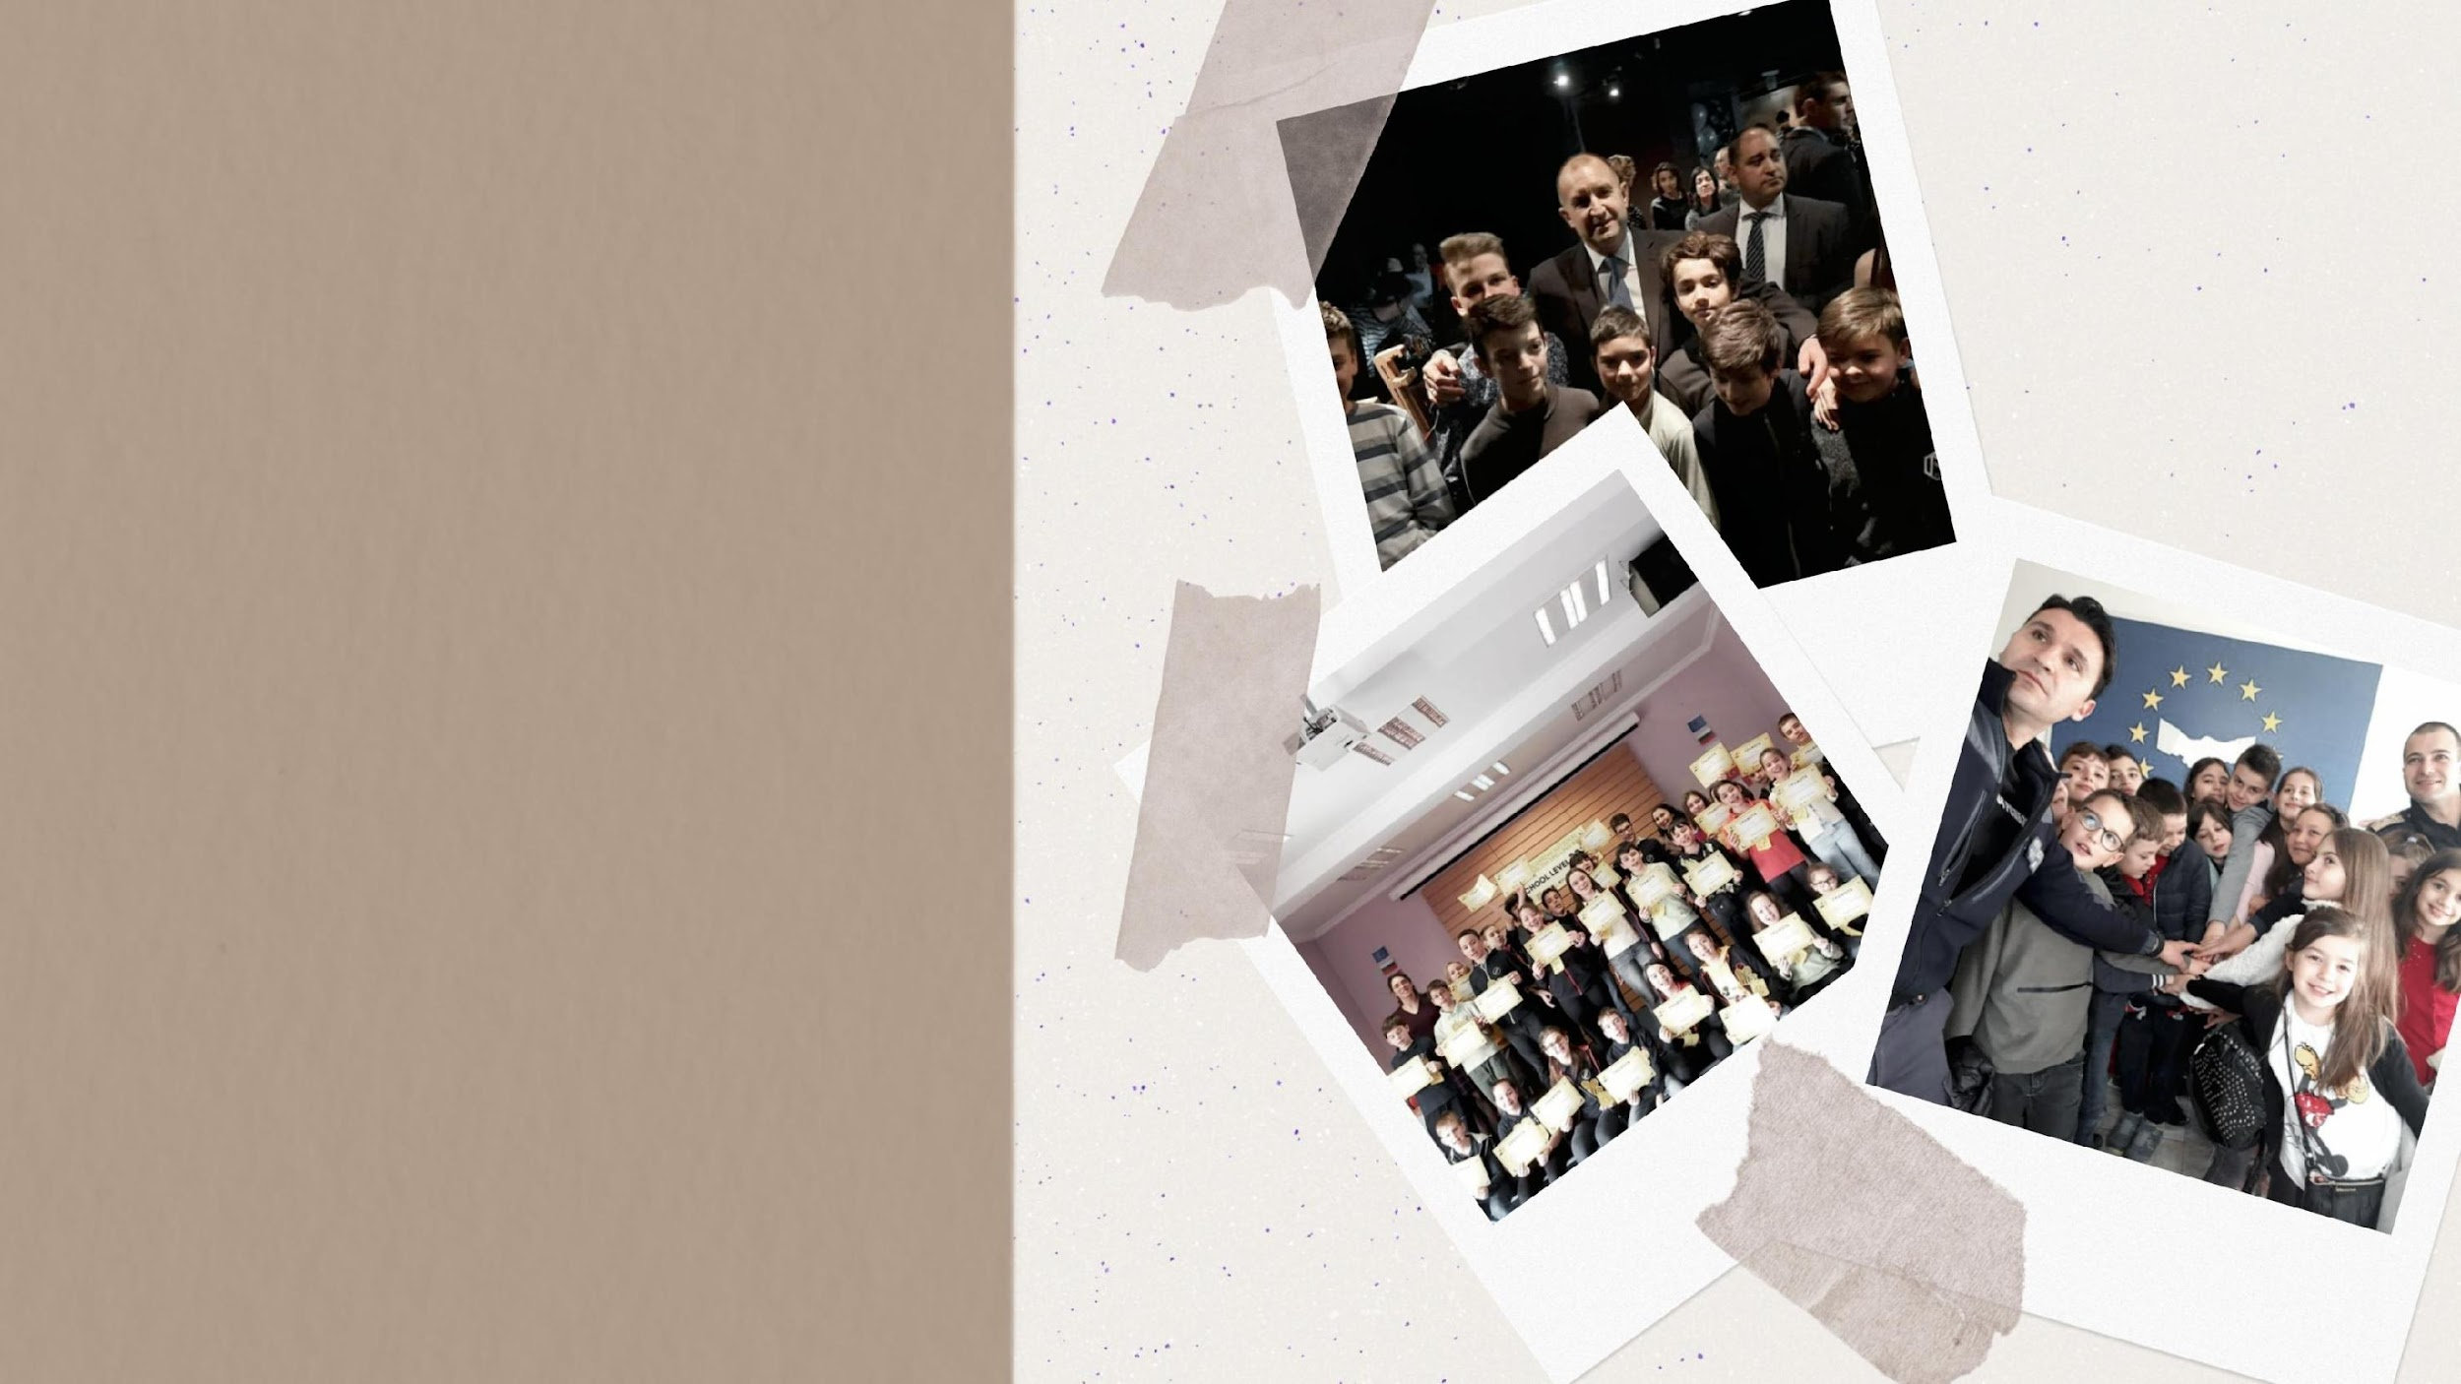
High project involvement – Erasmus+ (both for teachers and students), eTwinning school, European Parliament Ambassador school programme, educational and cultural exchange activities (many countries in Europe, Turkey, India, Russia)
Foreign languages learning focused – English (for all students), German, Spanish, French, Russian (optional as a second language); bilingual education; several profiling areas in 11th and 12th grades – Bulgarian language and literature, history, philosophy, maths and IT, biology and chemistry; variety of interesting extracurricular activities; access to the Internet everywhere in the school; specialized study rooms.

Slide 5
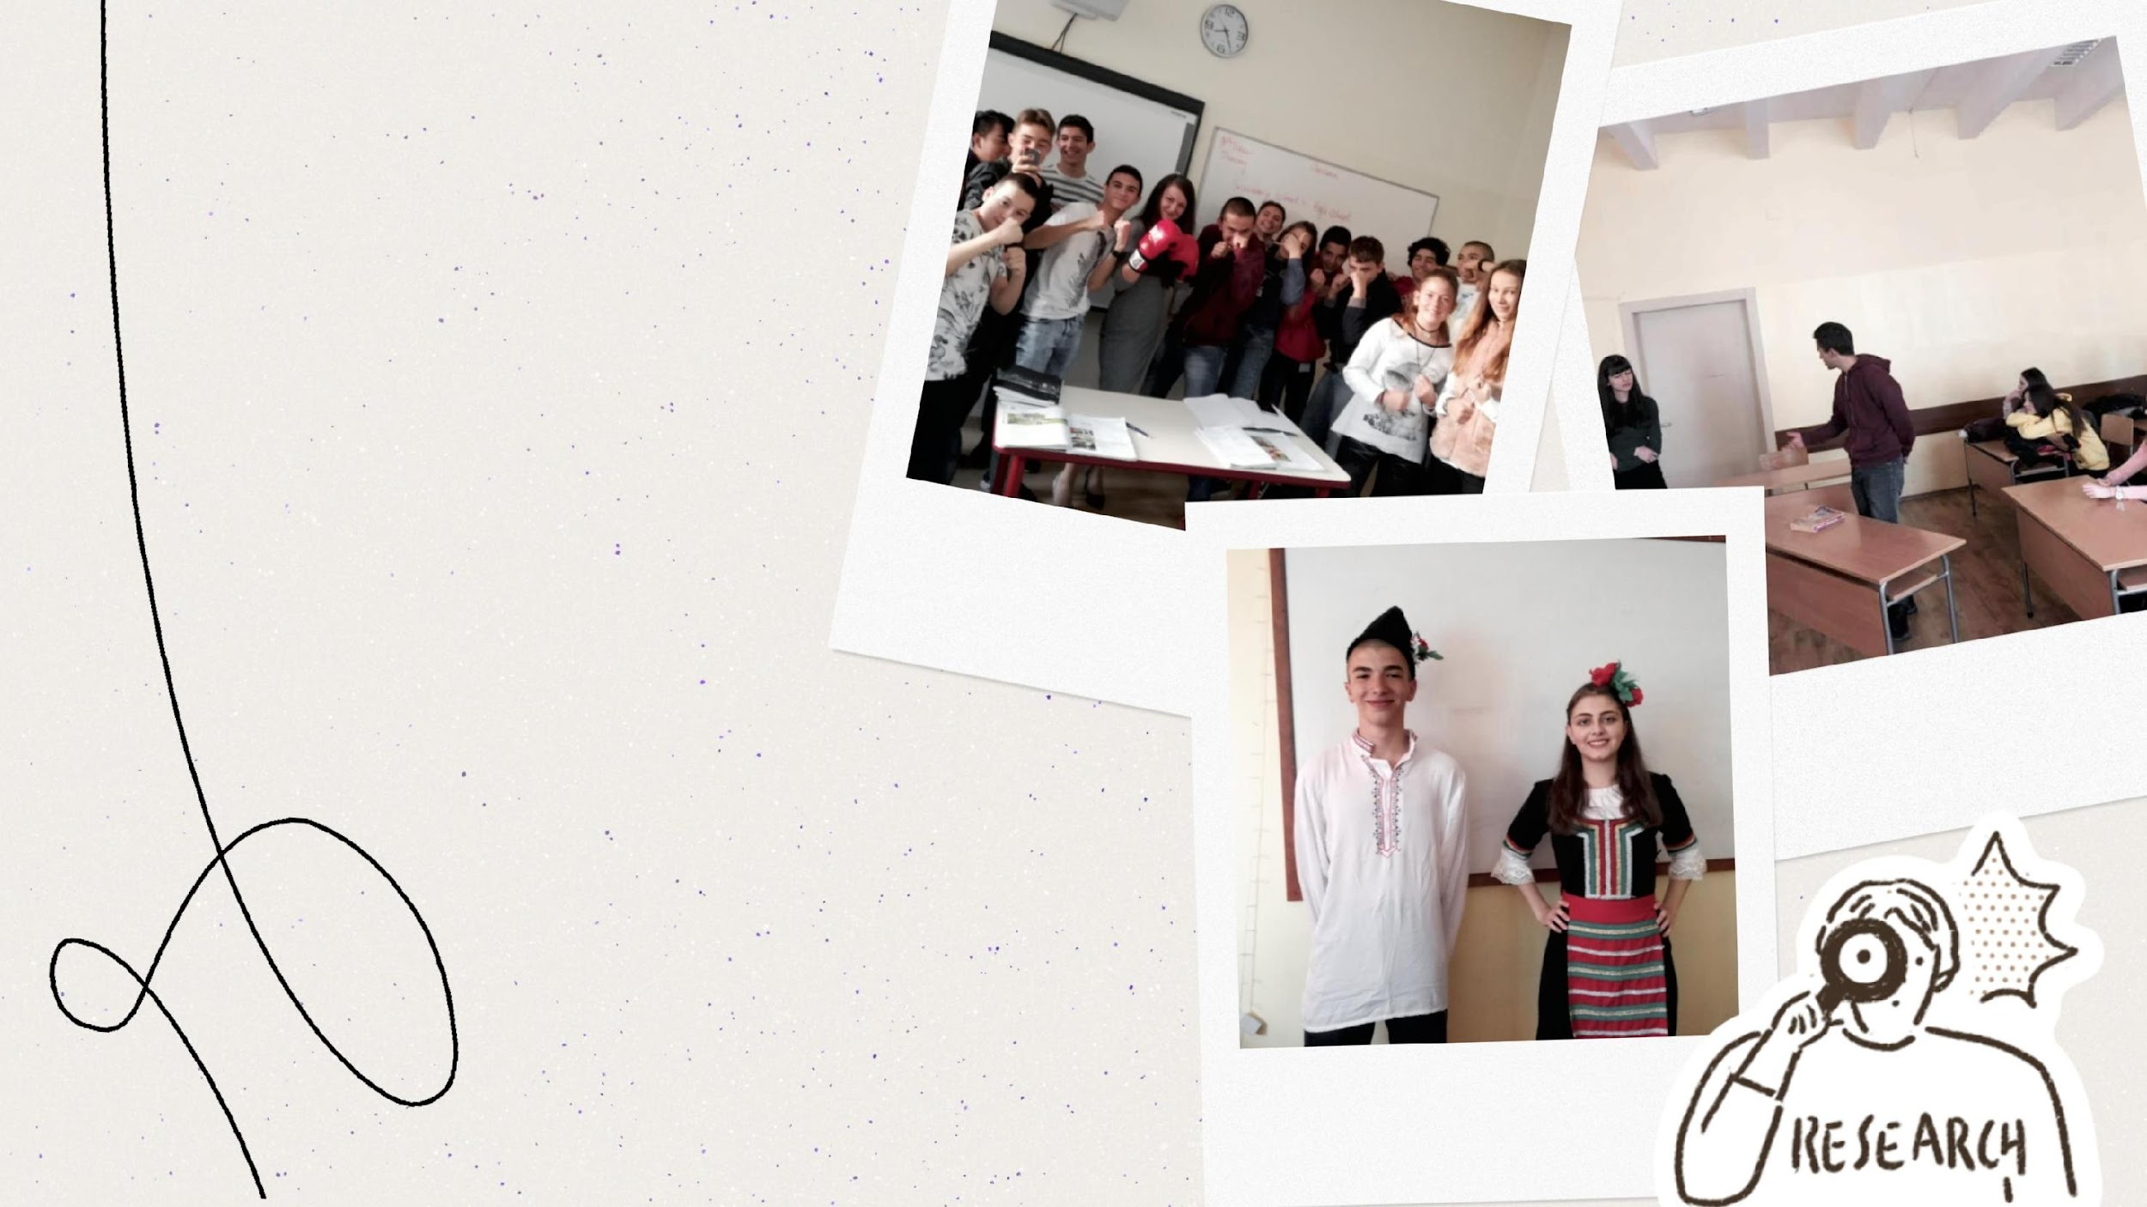
To be fair studying is not always easy, but in our school we try all sorts of new ways to make this process fun and not as hard as it seems. We play brain storming games, theater plays, debates and etc. We do extra research for most of those, but it is all worth it at the end.

Slide 6
In our school we try to discover every talent and our teachers supports every step the student takes so they can help them to grow and achieve great things .

Slide 7
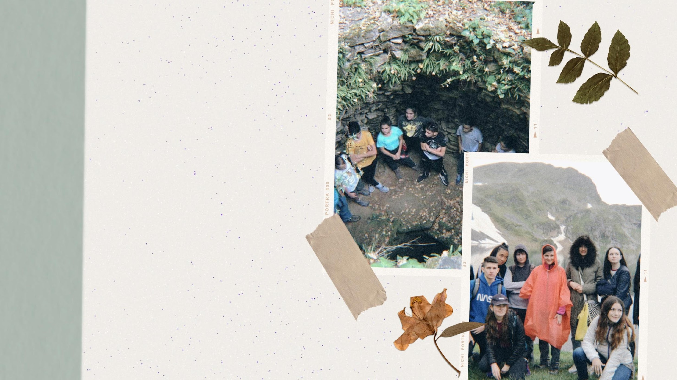
We also tend to organize trips around our own country for our children to get to know it. They last a few days, usually from 2 to 6 days, when the participating students can go to different cities or villages in order to see new places. As Bulgaria is a magnificent country they are lots of different sights worth of visiting. But Bulgaria is not only a bewitching country but a country with very old history. That's why visits to different cities and villages are educational for the students as we go to different attractions which show different parts of our history and different parts of our multicultural country.

Slide 8
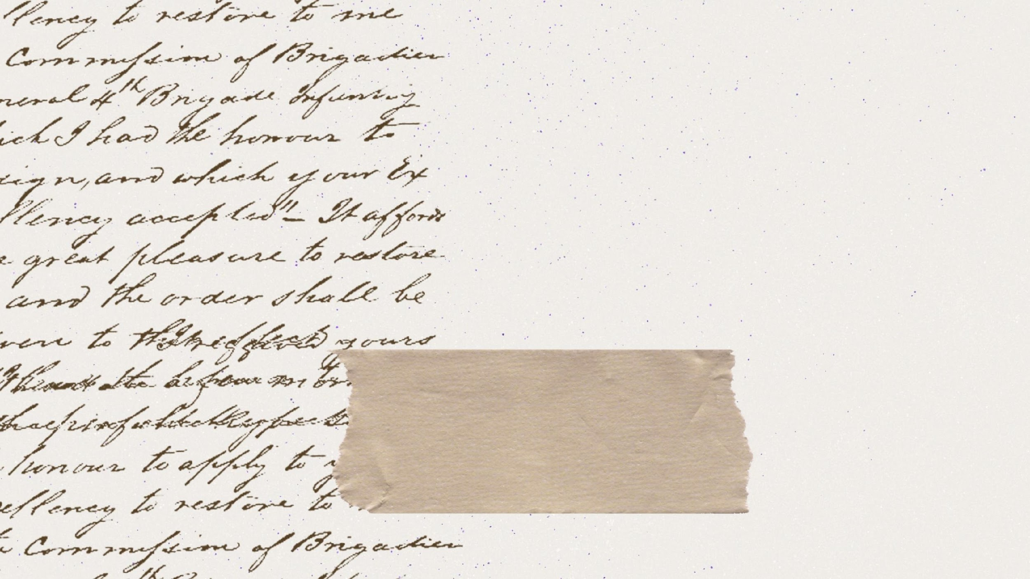
Thank you!
Presenting: Stilyana Nikolova and Siana Danailova

